Slide 1

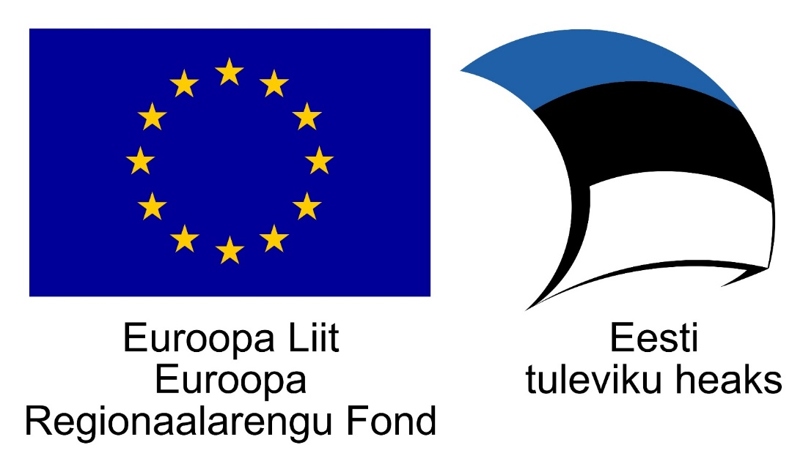
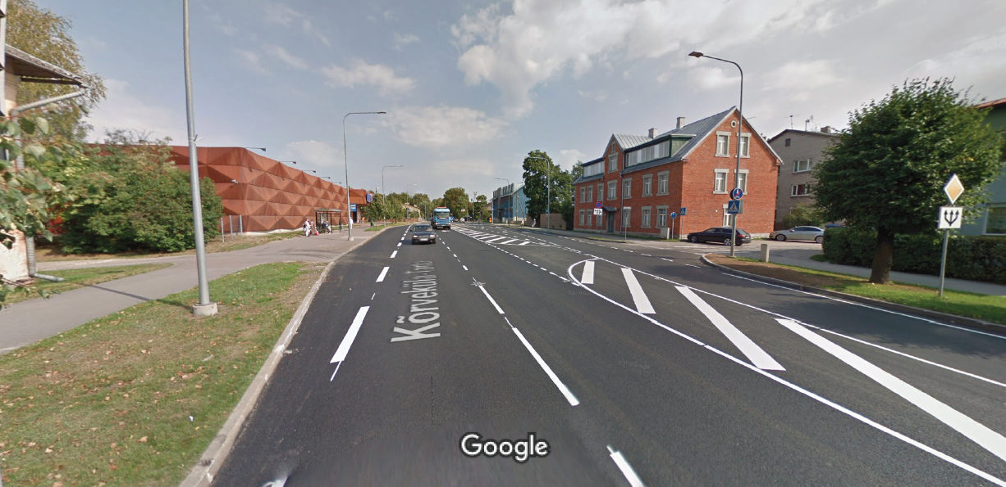
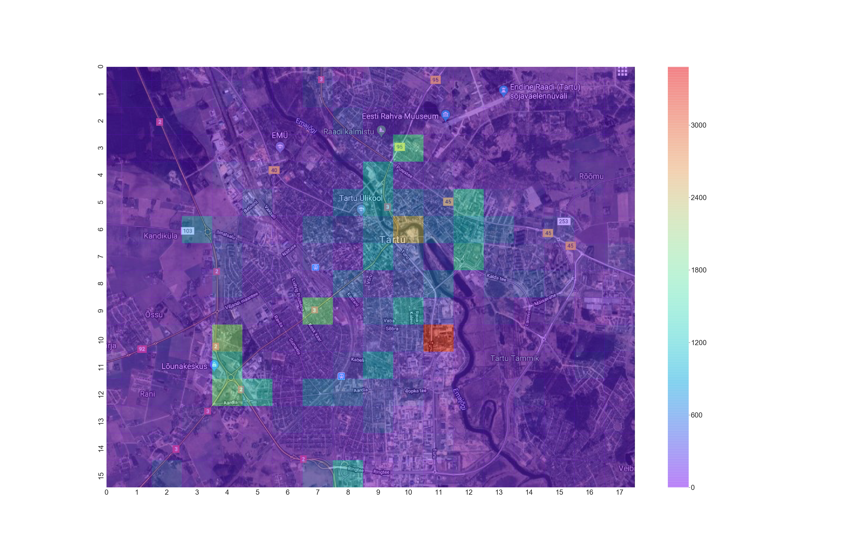
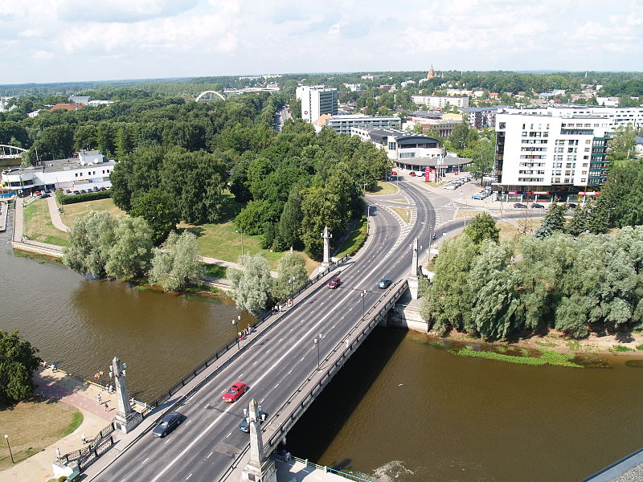
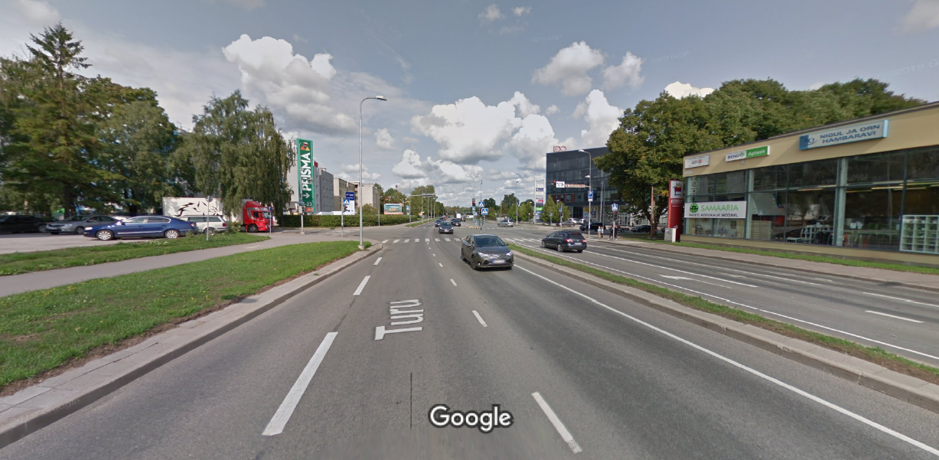
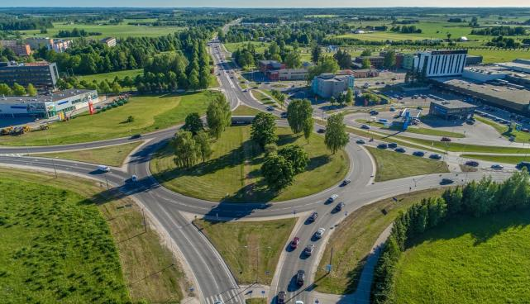
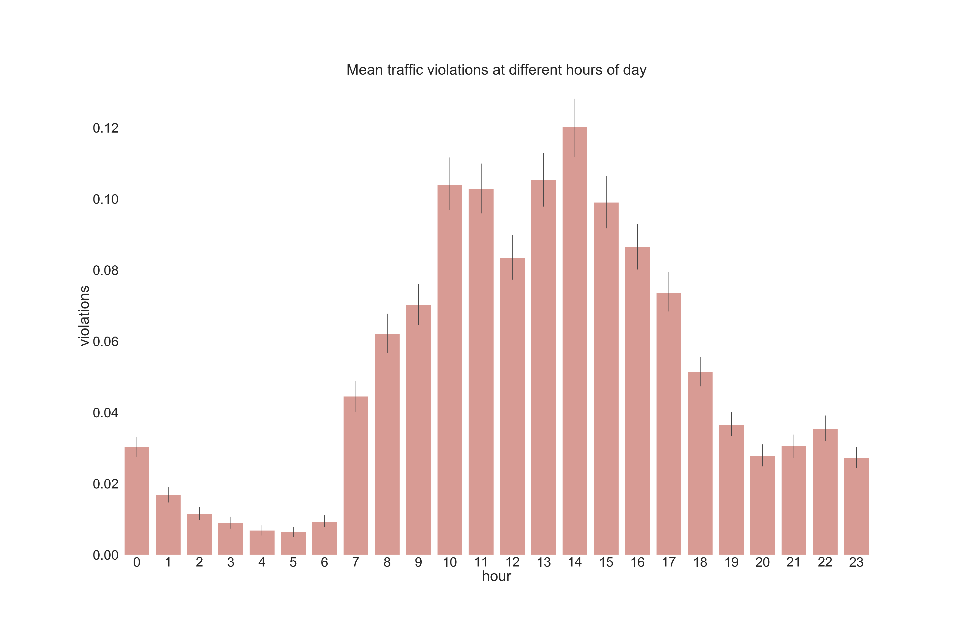
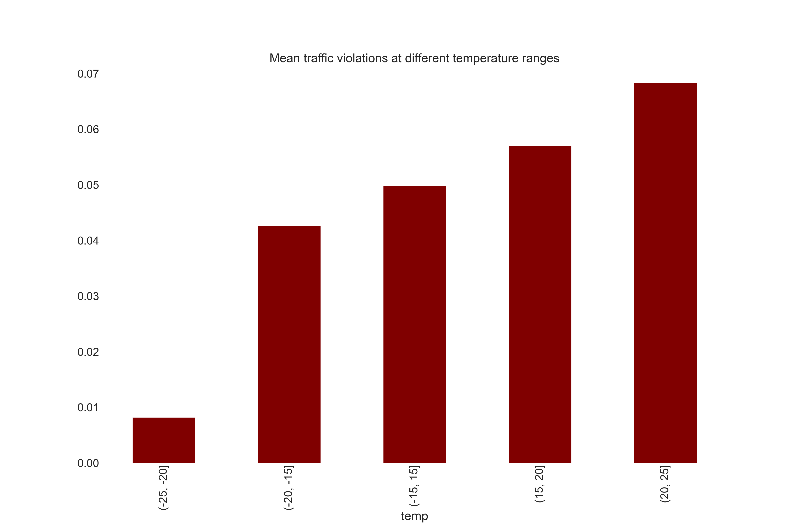
Traffic behavior dependence on location,
time and weather
Karl Marti Toots, Herman Klas Ratas
Motivation
Data
Traffic constitutes a major part of our societal routine. Traffic is governed and regulated by traffic laws for travel safety and efficiency for everyone. But with the determination of rules also come the events of breaking them. Violations and accidents in traffic are commonplace events in high population density areas like towns and cities. The violations are usually associated with bringing danger to other traffic users. It is the task of the law enforcement to catch and react to these violations in order to ensure the safety of traffic users. Tartu is the second largest city in Estonia and traffic violations occur there every day. Knowing more about where, when and in what conditions the violations occur the most could prove useful information to its citizens.
Data for traffic violations was gathered as open data from the
Estonian Police and Border Guard Board and weather data from
the observations made with the equipment of University of Tartu,
Institute of Physics, Laboratory of Environmental Physics. Data is
from the years 2012 – 2019 (11. December) and violations were
recorded for the whole country of Estonia, while the weather
data is recorded every 5 minutes for the city of Tartu. For the
graphs below, 42070 rows of data with 6 attributes were used.
Results
1379
Narva road by Maxima grocery store. Picture: Google Maps
2467
Võidu bridge in the city center. Picture: https://et.wikipedia.org/wiki/Fail:Tartu_V%C3%B5idu_sild_2011.JPG
2015
1800
3482
1736
Junction of Turu and Sõbra street. Picture: Google Maps
Roundabout at the end of Riia street. Picture: https://www.tartu.ee/en/node/7548
1) Heatmap of traffic violations for the city of Tartu
Conclusions
Lunchtime?
Legs are freezing, not enough strength to push the pedal
No relation between traffic
violations during dry and rainy
weather
Less violations during
weekends
On average, there were more
traffic violations with heavy rain
than with light rain
Violation hotspots varied
during the years under
observation
Low correlation between
weather and violations for
predictive models
More violations during higher
illuminance
Source code:
https://github.com/karlmartitoots/DataScienceProject

